Slide 1


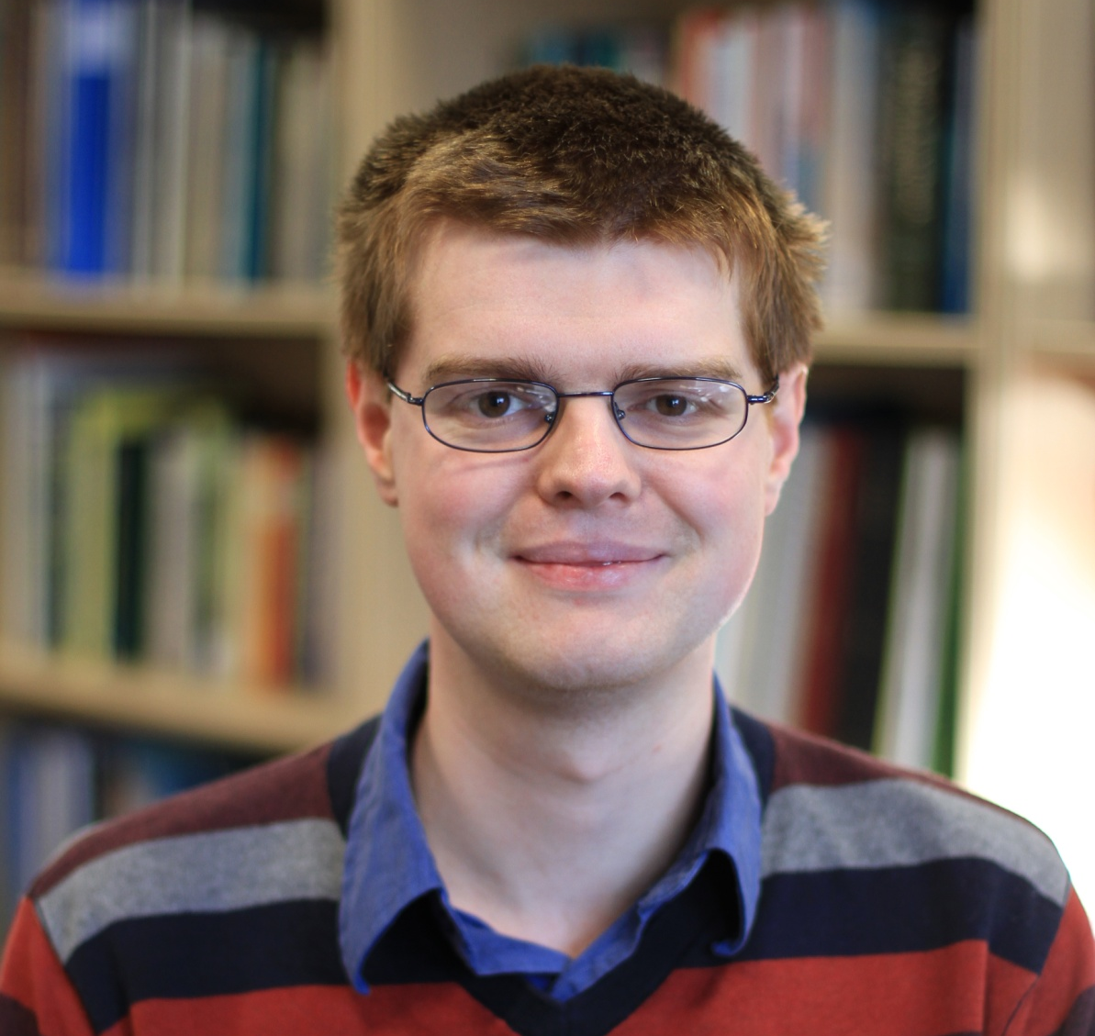
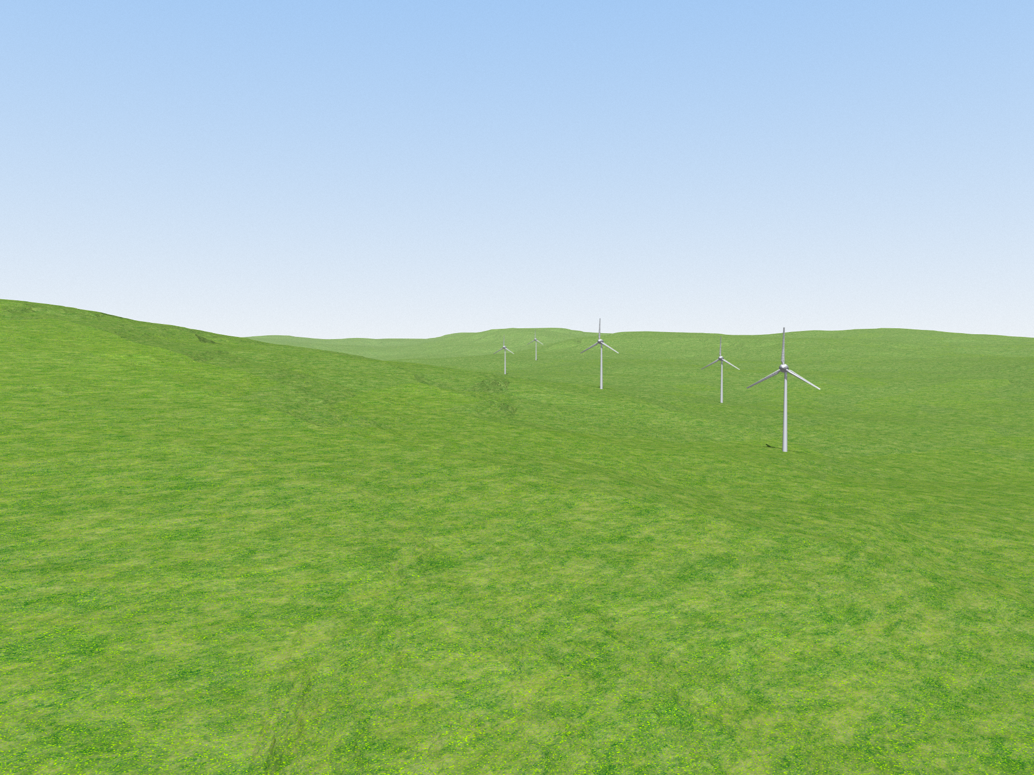
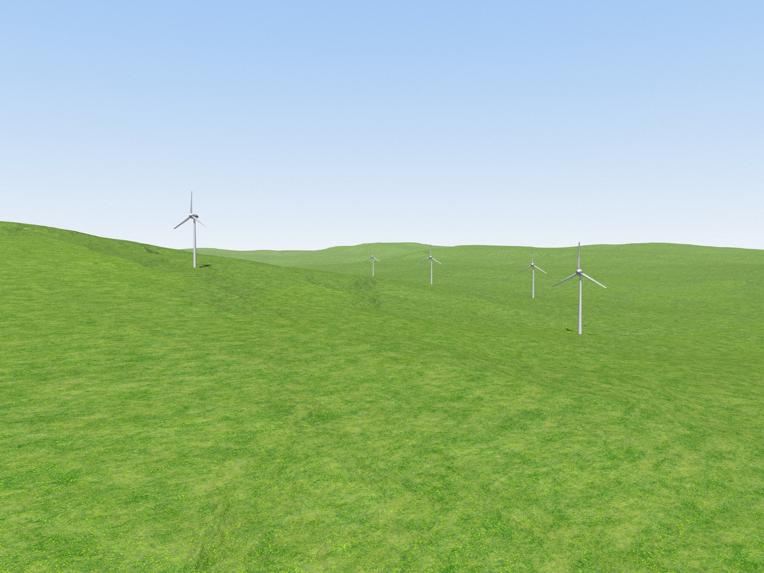
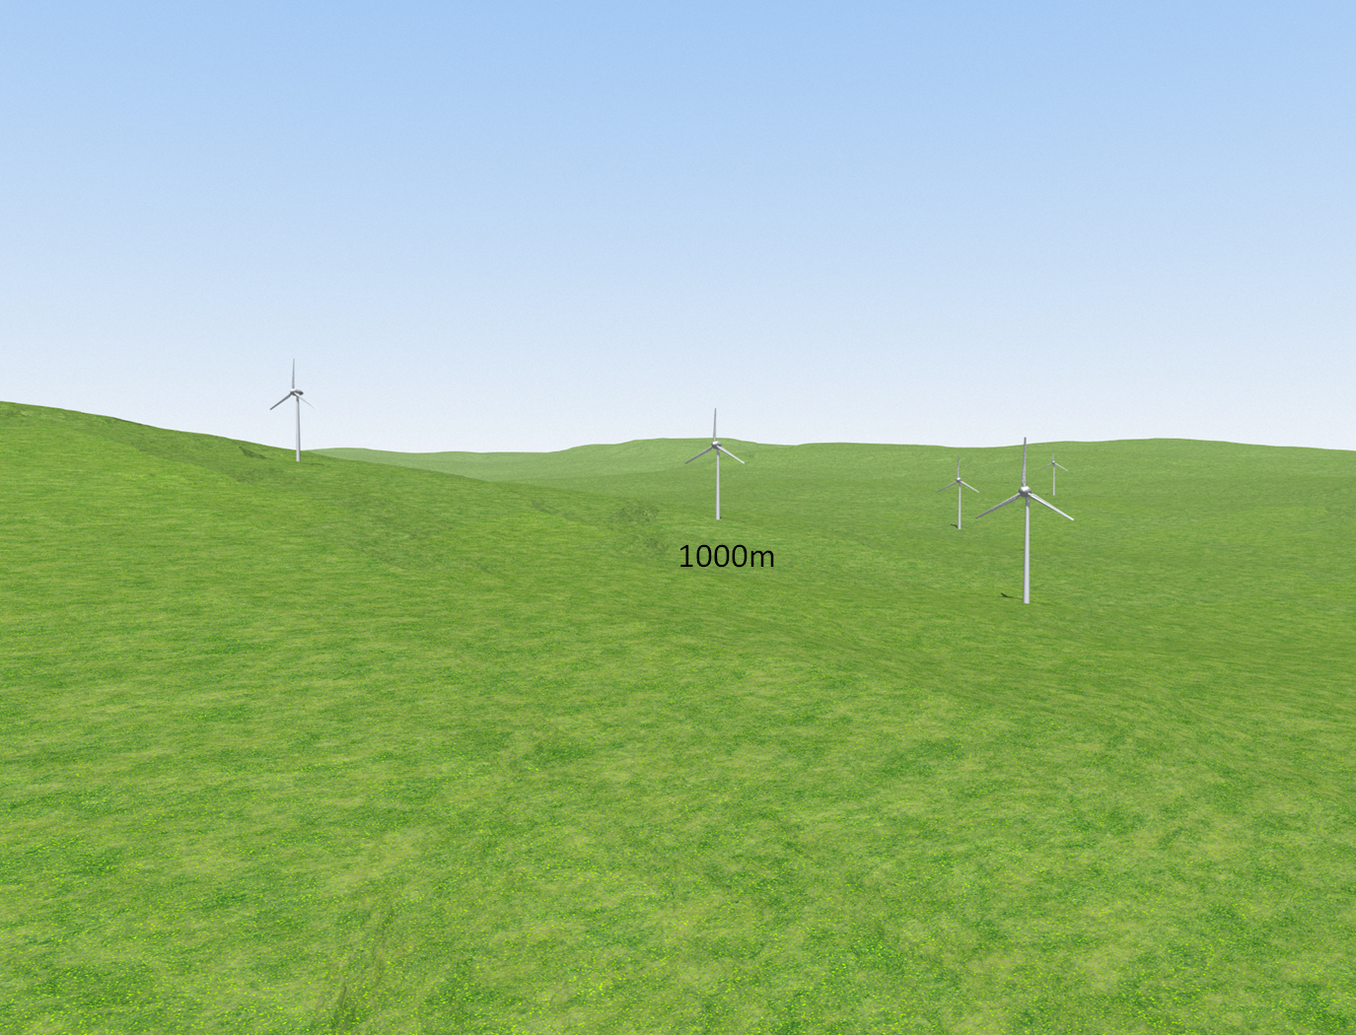

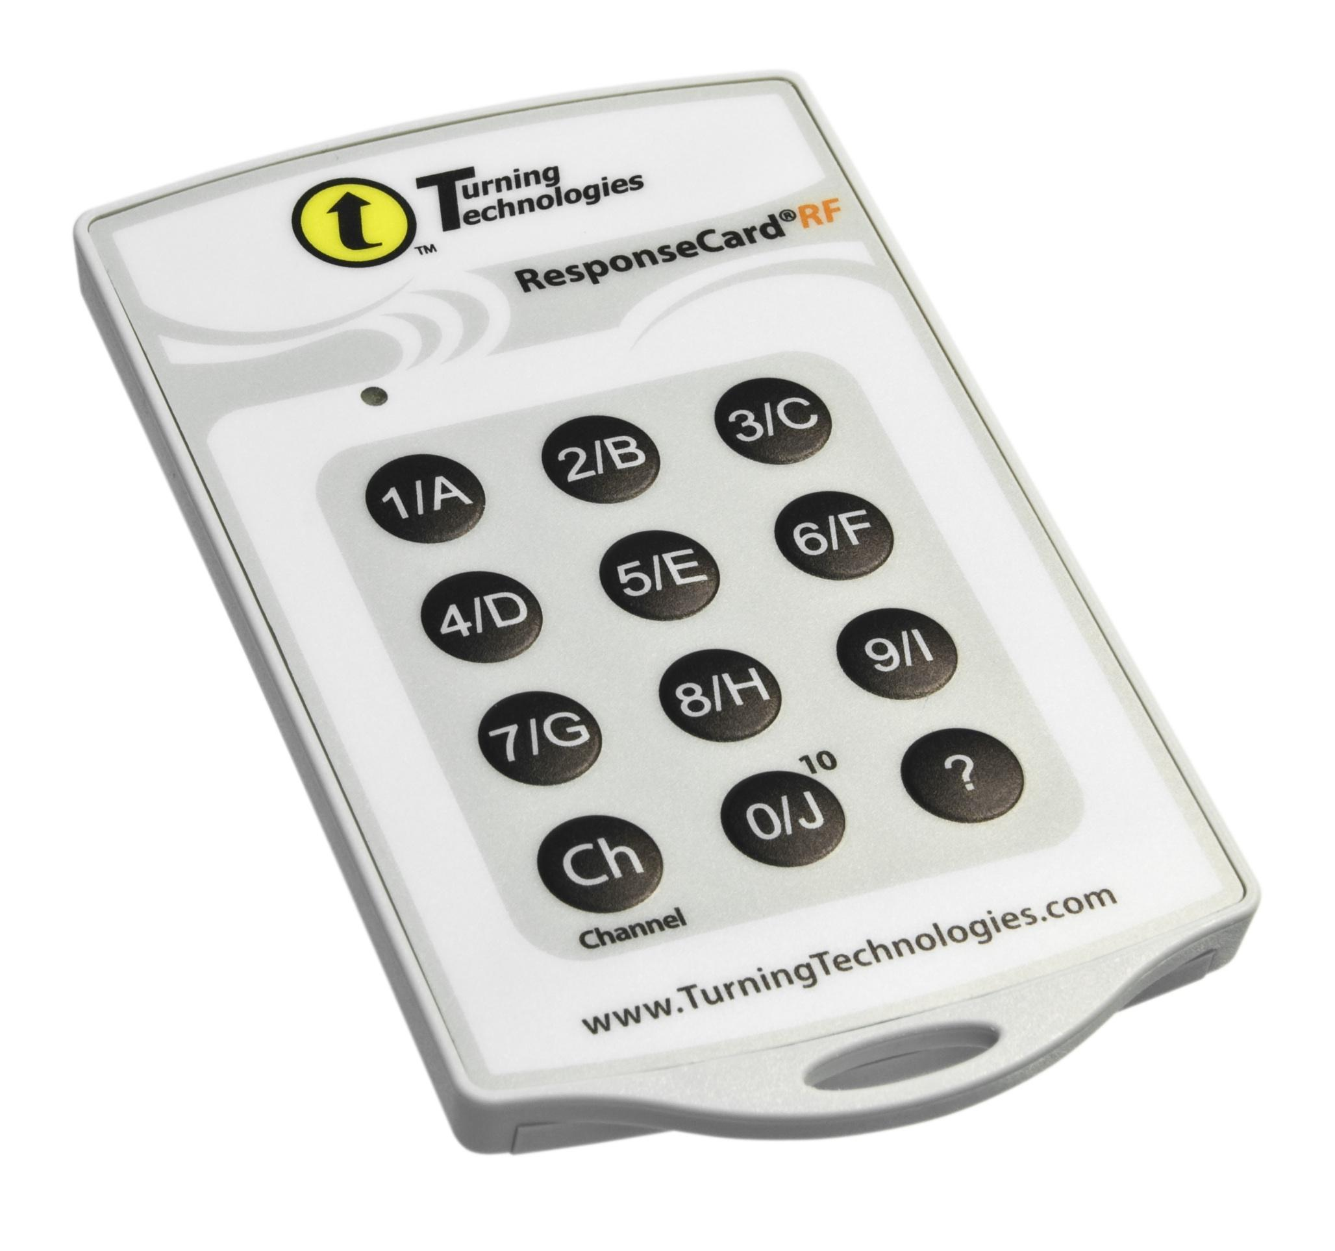





Can Sound Help Represent Distance in a Landscape Visualisation Setting?
The amount of spatial data that needs to be analysed is increasing dramatically, particularly with the need for uncertainty in spatial data to be represented effectively. This work forms part of my PhD work evaluating the use of sound to represent uncertainty in spatial data.
The need to represent and analyse larger and larger sets of spatial data is clear. Can we use sound to help us do this?
This work looks at how sound can be used to represent the distance of wind turbines in a landscape visualisation setting, using piano notes and bird calls. The sonification was tested on 45 participants familiar with geographic information. Using sound and vision together was significantly more successful than vision alone (p < 0.001) and piano notes were generally more successful than bird calls. A binary logistic regression analysis showed that participants who pay attention to sounds and the number of attempts were significant factors for most methods.
Nick Bearman & Andrew Lovett, School of Environmental Sciences, UEA
Sonification
Sonification refers to the presentation of information using non-speech audio and covers many fields (Dubus & Bresin 2011) but it is relatively new to GIS. It can be used to represent complex data sets in a way that would be very difficult with visual methods. It also works as a way of reinforcing data communicated visually (Harrower, 2007).
Sonification prototypes of spatial data have been created (e.g. Fisher, 1994; MacVeigh & Jacobson, 2007) but with limited user testing to see if they actually work.
Dubus & Bresin (2011) Sonification of physical quantities throughout history, ICAD. Budapest, Hungary.
Fisher (1994) Hearing the Reliability in Classified Remotely Sensed Images. Cartography and GIS, 21(1), pp.31-36.
Harrower (2007) The Cognitive Limits of Animated Maps. Cartographica, 42(4), pp.349-357.
MacVeigh & Jacobson (2007) Increasing the dimensionality of a GIS using auditory display, ICAD. Montréal, Canada.
Nick Bearman
Landscape Visualisation
Landscape visualisation is used in planning to assess potential visual impact of a development (Appleton & Lovett, 2003). In recent years the use of computer based landscape visualisation has come to the forefront, providing advantages (and some limitations) over physical models and photomontages (Lange, 2011). Perception of landscape visualisations varies due to many characteristics and it is important to interpret distance correctly. Visual methods of representing distance may detract from and/or obscure parts of the visualisation, whereas sound would not.
Appleton & Lovett (2003) GIS-based visualisation of rural landscapes: defining `sufficient’ realism for environmental decision-making. Landscape and Urban Pln., 65(3), pp.117-131.
Lange (2011) 99 volumes later: We can visualise. Now what? Landscape and Urban Planning, 100(4), pp.403-406.
QR Code?
Collecting the Data
We created 18 visualisations with 5 wind turbines on each placed at distances between 800 and 3000m. The visualisations were created using Visual Nature Studio 2.85 (3D Nature) with a field of view of 60 degrees (the same as a photo taken using a wide angle lens). Some examples of the visualisations are shown below and to the right.
Evaluation sessions were run in small groups (2 to 8) with participants recruited from UEA, Ordnance Survey, UK Climate Impacts Programme, the Broads Authority and planners from Norfolk County Council (n = 45).
Responses were collected using an audience response system (Turning Point) consisting of slides integrated into Microsoft PowerPoint and handheld keypads.
Piano & Bird call note images
The participants were asked how many turbines were within 2000m, using four different methods to represent the distance of the turbines:
Vision Only: Just the visualisation (see left & above).
Vision & Sound: The visualisation with sound (either piano notes or bird calls).
Sound Only: Just the sound.
Vision with Scale: The visualisation with the turbine at 1000m marked (see right).
To hear the sound scan the QR code or see the URL below
Results
The number of turbines the participants thought were within 2000m was compared to the correct answer for each visualisation, with a value of 0 being correct, a negative value being an underestimation and a positive value being an overestimation.
The graph below shows how successful the different methods were.
Sound Only with piano notes was the most successful and Vision Only the least successful.
Piano notes were more successful than bird calls, which were also more successful than Vision Only.
Conclusion
Using sound to represent the distance of the wind turbines can help users judge distance in a landscape visualisation. The sonic methods were more successful than the visual methods and have the potential to work well in a landscape visualisation.
The sounds chosen for a sonification are very important, with piano notes much more useful than bird calls. More research needs to be completed on which sounds work best for different data sets and different users.
The visualisations were not photo-realistic because of time restraints, but a truly photo-realistic visualisation does not necessarily result in better understanding of the landscape.
Adding a second labelled turbine at 3000m to the Vision Only method would make the data more comparable to the other methods.
This work provides a contribution to the literature as an evaluation of sonification in an area where few evaluations have been completed and provides some evidence for the importance of choosing the correct sound.
Sonification has wider applications in spatial data representation, where it is useful to present large or complex data sets that cannot be shown visually.
It may also be more appropriate for some users than complex visual methods, such as users who do not find visual methods useful.
‘You pay attention to the sounds of various things’
Is this statement:
Very much like me
Partially like me
Nothing like me
?
Exploration of the results and a logistic regression showed that:
Participants more often overestimated the number of turbines than underestimated.
Knowledge of GIS made no significant difference to performance.
People who said they tended to listen to sounds performed less well.
As people had more practice with bird call sonifications, their performance increased.
Acknowledgements
This research has been conducted as part of ESRC/NERC PhD Studentship No. ES/F012454/1 with additional financial support from Ordnance Survey. Thanks also to the participants, and ECEHH for financial support for this poster and conference attendance.
Biography
Nick Bearman has recently submitted his PhD in the School of Environmental Sciences at UEA, researching different methods of representing uncertainty using sound in a variety of spatial data environments. He is now working as a post-doctoral research fellow at the European Centre for Environment and Human Health (Peninsula College of Medicine & Dentistry, Universities of Exeter & Plymouth).
For examples of the sound, see http://nickbearman.me.uk/go/bearman_lovett_2012_gisruk
Nick Bearman ¦ European Centre for Environment and Human Health, Knowledge Spa, Royal Cornwall Hospital, Truro, Cornwall, TR1 3HD ¦ Tel: +44 (0)7717 745715 ¦ n.bearman@uea.ac.uk ¦ ¦ Andrew Lovett ¦ School of Environmental Sciences, University of East Anglia, Norwich, NR4 7TJ ¦ a.lovett@uea.ac.uk

